Slide 1
Receiver Calibration Overview
Daniel Molnar
18/01/2024, Receiver Calibration meeting

Slide 2
Overview
Calibration meeting
Intro and welcome
Receiver noise
Calibration of a generic LNA
Switching
Noise descriptions
REACH receiver
Discussion and Outlook

Slide 3
Agenda for today’s meeting
Notations and overview
-Daniel and Harry
Forward modelling
- S-parameter based model of FE: Dirk and Saurabh
-Noisy Cable modelling: Martin and Daniel
-Mock data generation:
-Kaan
-Jiacong
Calibration Strategies
-Least Squares , Kaan, Jiacong
-Machine Learning :Sam
-Gaussian Processes: Christian
-Conjugate priors :Christian
AOB receiver calibration
Discussion and future

Slide 4
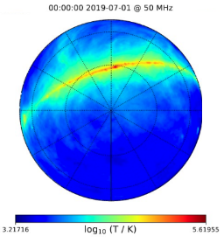
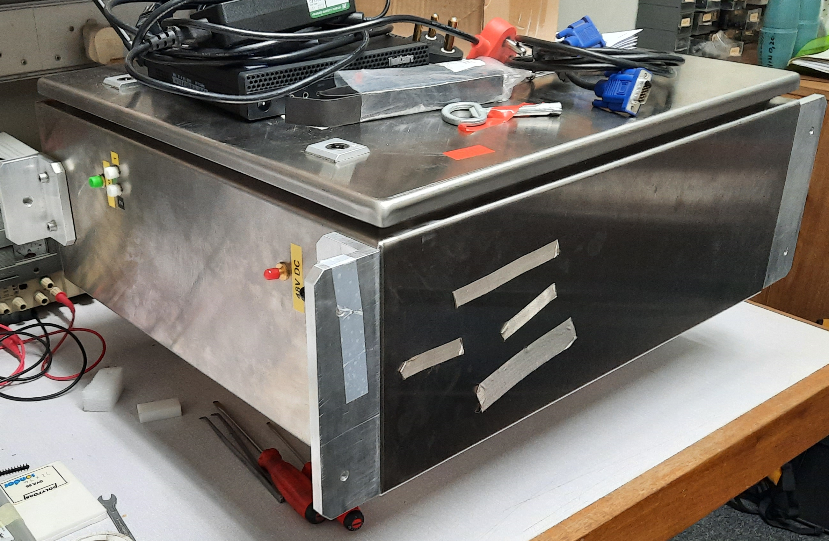
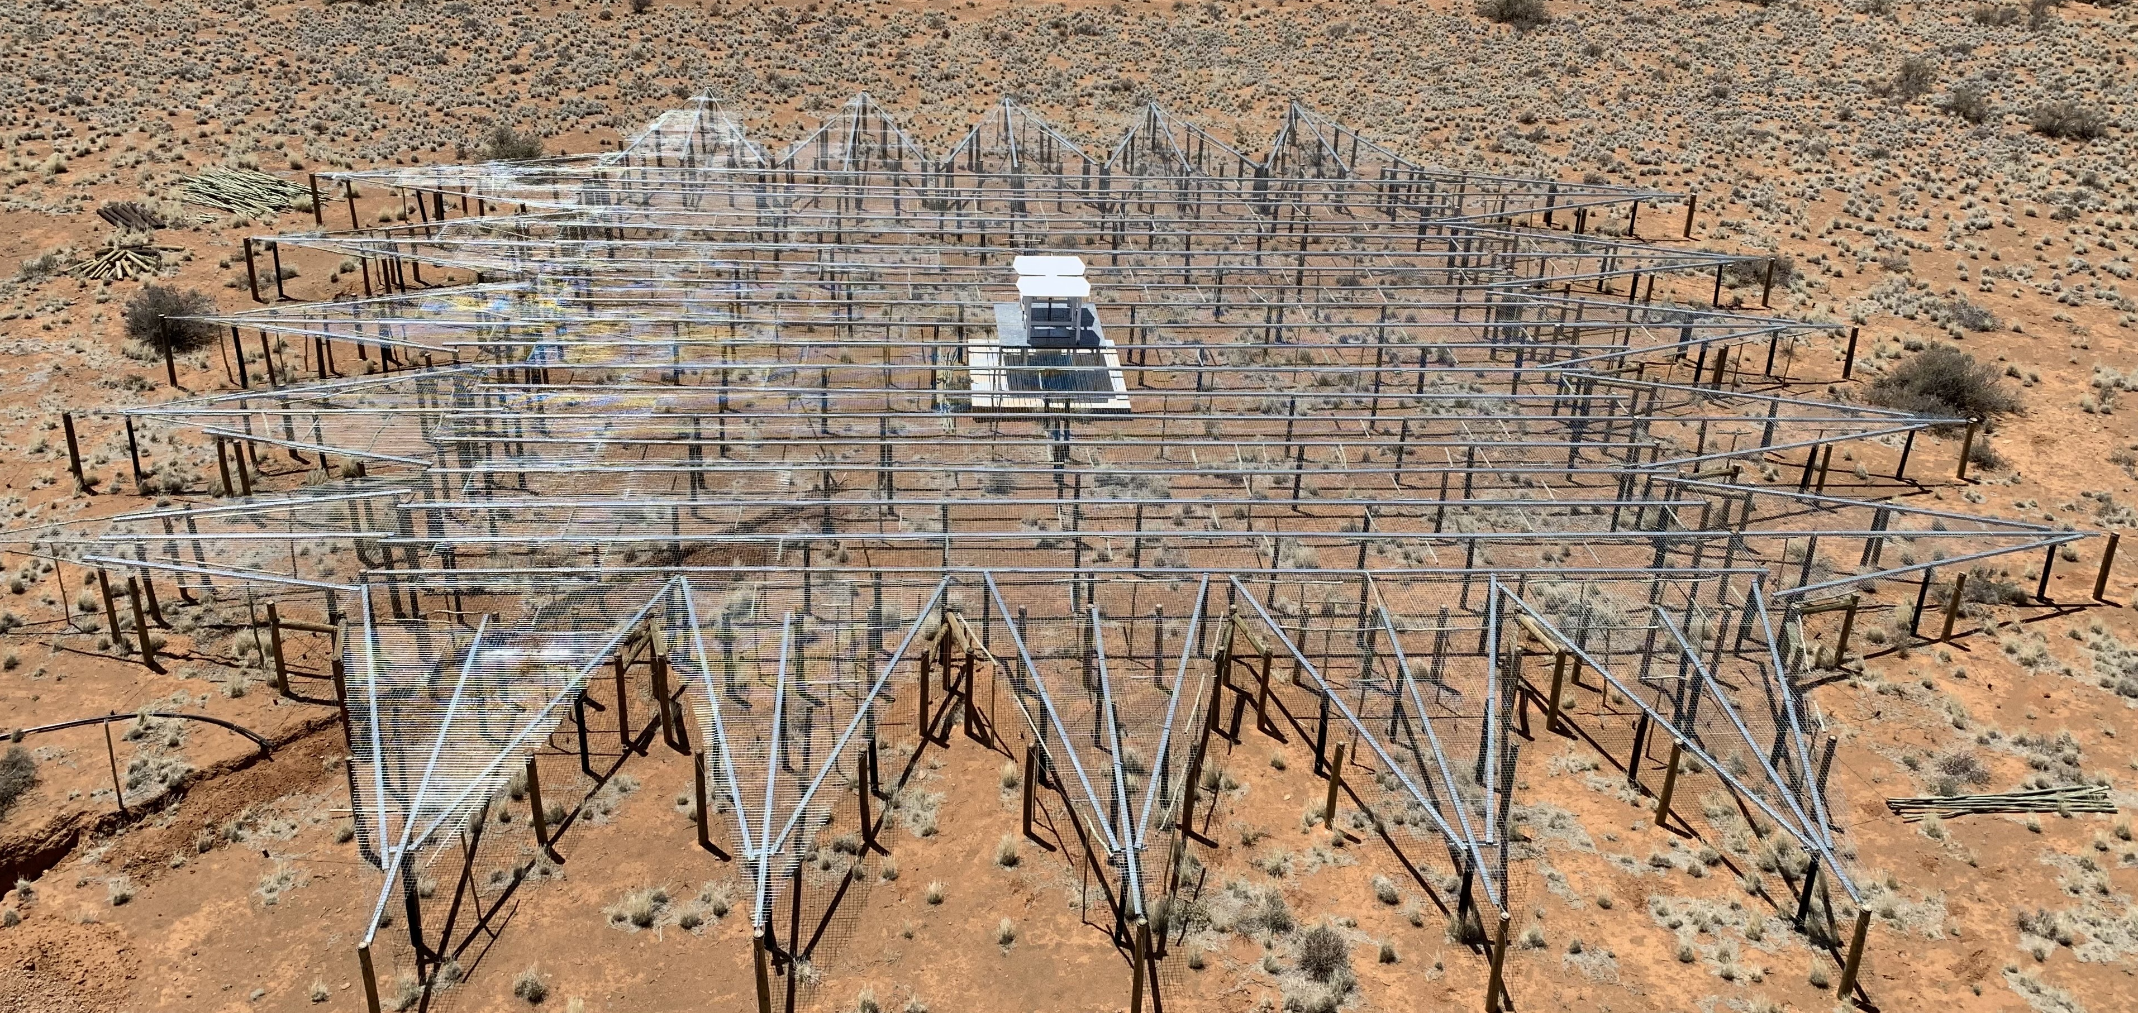
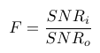
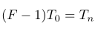
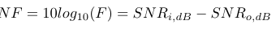
Receiver noise
Ideal Receiver
Antenna
Detected Signal

Slide 5
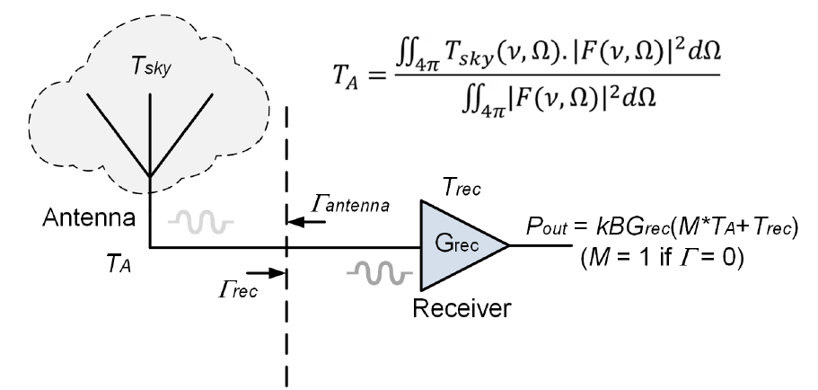
Receiver Calibration cont.
Schematic representation of a global 21cm receiver (from REACH radiometer paper)
This basic setup is also important for mock data and ML (see Kaan’s and Sam’s talks)

Slide 6
Calibration of a generic LNA
The issue: any microwave amplifier (device) will have different noise characteristics based on the source and load devices’ reflection coefficients
In general characterizing it to a given reflection coefficient has to be done each time when Γ(S₁₁ or input impedance Z ) changes
Noise characterization can be done in various ways, 4 parameters, Meys noise wave or REACH noise wave
Design considerations for REACH: reduce S₁₁ of LNA to 30dB or below and try to minimize temperature variation too

Slide 7
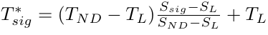
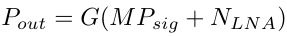
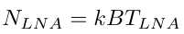
Uncalibrated T from switching
For the uncalibrated T* we can obtain the following:
T*_{sig}
T_{ND}
LNA
S(ν)
T_{L}
T₀,G*
Power at LNA output:

Slide 8
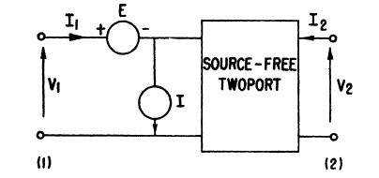
Noisy devices general description
The basis: given a noisy two port represented by its Impedance matrix (or equivalently by S, Y or T)
Transform it into an equivalent noiseless two-port with noise generators (voltage and current) at the input of the device
Input and output can be transformed by appropriate matrix inversion
From Atkinson et al

Slide 9
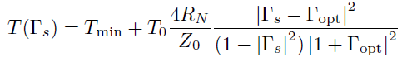
Noise parameters of a device
In general, 4 real parameters are needed to characterize a noisy two port (see eg: Martin’s Malta talk, Atkinson et al or Rothe et al for derivation)
This could be extended to noisy NPorts (Bucher and Molnar in prep)
Using the derivation and notation in Atkinson et al and expressing the noise T:
Or equivalently :
NB: this is what Price et al use too

Slide 10
REACH LNA-4 noise parameters
REACH LNA measured 4 noise parameters
Currently used data for mock data (cf Kaan and Jiacong)
Currently researching to get a better measurement: in-house maybe our best option!

Slide 11
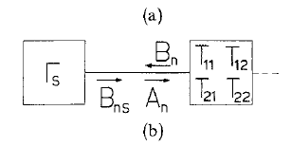
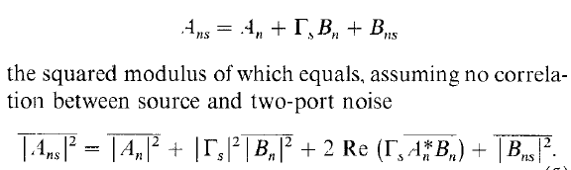
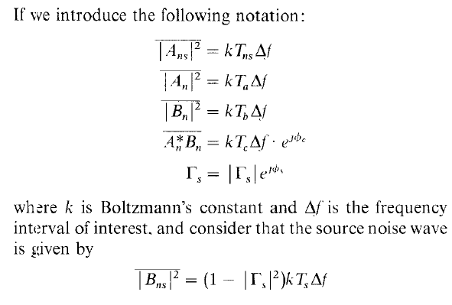
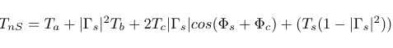
Noise waves of Meys
From Meys’ paper
This is shown to be equivalent to 4 param

Slide 12
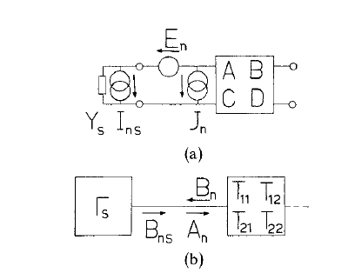
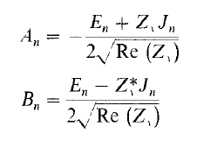
Meys definitions

Slide 13
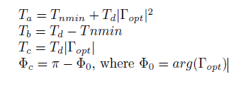
Meys noise waves and 4 parameters
In Meys’ paper the conversion between the 4 np and NW is also given
REACH LNA Meys noise waves

Slide 14
Noise Waves of REACH
The received power is a relatively complicated function of the antenna power due to reflections
The relation of antenna power to sky temperature is another story
The schematic is representing how to get the formulae that Roque et al are using in the conjugate priors and REACH Rx papers
D
F
A
C
ANT
B
REC
G
E
H
Γ_{A}
Γ_{REC}
Receiver intrinsic
Each latin letter represents a microwave

Slide 15
Noise waves
D
F
The received power at the output of the LNA from P_{F}*G
If LNA noise is an extra T at the input of LNA
If the REC(LNA) emits towards the antenna noise wave (i.e. noise) the extra terms can be added and calculated
A
C
ANT
B
REC
G
E
H
Γ_{A}
Γ_{REC}
Receiver intrinsic
P_{out}=G(P_{F}+P_{G}+P_{H})
Nb in our notations: P_{F}=P_{A}/M but P_{G} is missing somehow or is subsumed into P_{rec}, in EDGES P_{G+H} is dealt with to get to their equations and also Ian’s P_{H} is just T0 in both

Slide 16
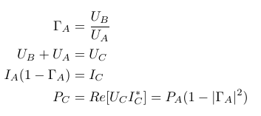
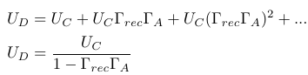
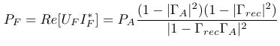
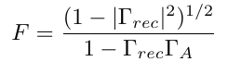
Waves continued
From definitions of reflection coeff. and power and after some (a lot) of algebra
The power from the antenna at the LNA
The factor M from earlier
Total power:

Slide 17
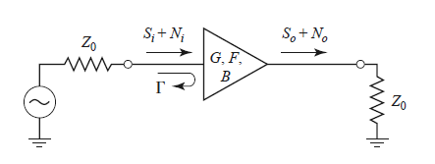
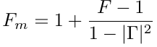
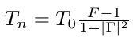
Mismatched amplifier-Pozar notation
In Pozar it’s described in page 510
The formulae are simpler because G,F are for matched impedance (Z0 , or 50Ω)
Working through the equations the noise factor or equivalently noise Temperature

Slide 18
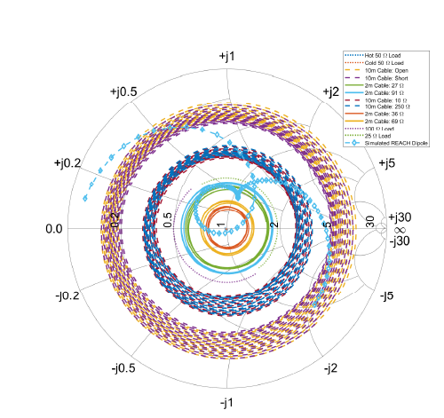
REACH calibration
The REACH approach : Since the S₁₁ of the antenna can be simulated (measured) the input impedance to the LNA is known cover the Smith chart
From the radiometer paper

Slide 19
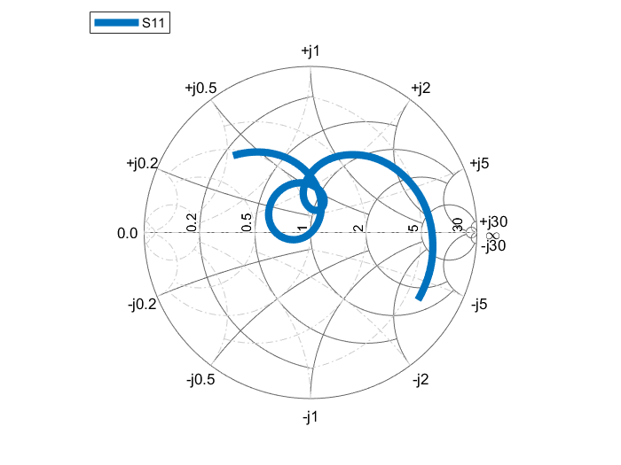
Antenna S11
Smith chart of the antenna S11 from simulation

Slide 20
The REACH Receiver chain
The schematic of the Front end of the REACH receiver

Slide 21
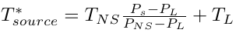
The sensitivity of the calibration
The intrinsic errors in the measurement will affect (absolute) sensitivity eg. Temp
As long as uncertainties are smooth functions of frequency it should be fine
The reflection coefficients are also measured with a given tolerance

Slide 22
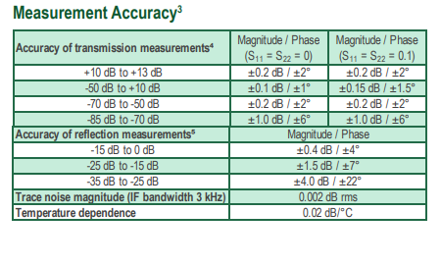
VNA specifications

Slide 23
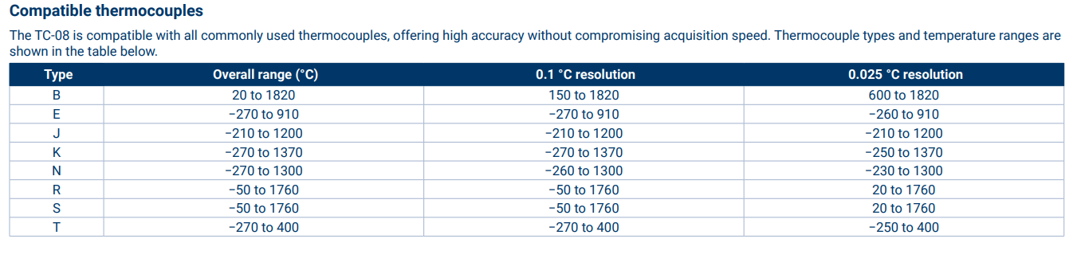
Temperature measurements

Slide 24
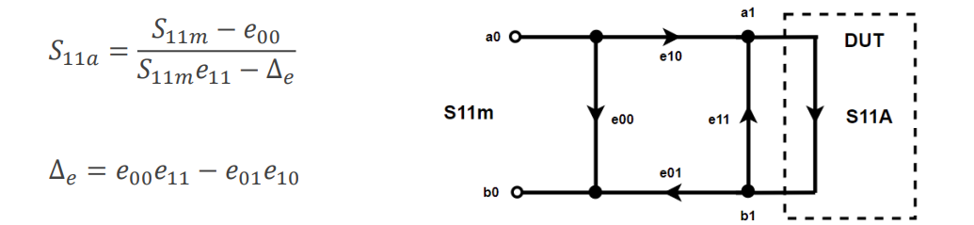
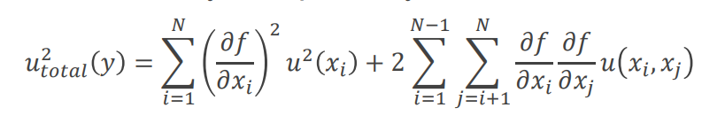
Error propagation
Strategy: we are looking at measurement errors and assume that the input variables have Gaussian pdfs
Propagation of error formula applied to the calibration equations
The resulting temperature is fed into the pipeline, two profile: flat and power law with Gaussian signal

Slide 25
Discussion
What absolute sensitivity do we need? ->motivated by data analysis pipeline, also see forward modelling session, eg.: Dirk, Kaan
What integration time should we settle on? ->
What are the first order and second order effects(i.e. to get a calibration and to get a given sensitivity calibration)? –e.g. Cable correction, see Martin
What calibration strategy should we use? ->Calibration strategies session
Are the noise wave / noise parameter formalisms equivalent? ->Meys &4 param yes, cf later Jiacong
What are limitations on our current analytical approaches – i.e. are there effects that these methods ignore that could be problematic at our scales?

Slide 26
Solutions being implemented
We need further temperature measurements of sources and cables: another TC08 is the most straightforward
Temperature stability: even without issues the current design is being evaluated : tec improvements including thermal link are being designed/implemented
Insulation of the box being looked at, what material we could use and thickness
Current system is hardware based, software implementation is being looked at for parts of temperature control (eg:fan)
Go pro to monitor the state of FE (Harry’s suggestion) ☺

Slide 27
Bibliography
[1]: David M.Pozar: Microwave Engineering
[2]: Atkinson et al: Representation of Noise in Linear Two Ports Representation of Noise in Linear Twoports | IEEE Journals & Magazine | IEEE Xplore
[3]: REACH AGM, Malta 2023:REACH annual meeting 2023 - Google Drive
[4]: REACH radiometer design paper:[2307.00099] Receiver design for the REACH global 21-cm signal experiment (arxiv.org)
[5]: Meys: A wave approach to the noise properties of linear microwave devices

Slide 28
Thanks

Slide 29
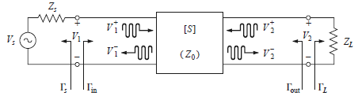
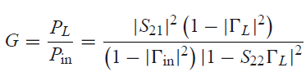
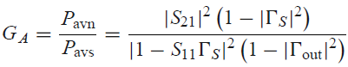
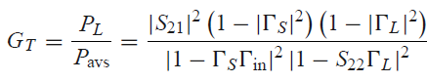
Power gains
From Pozar ch. 12.1
Power gain:
Available power gain:
Transducer power gain:

Slide 30
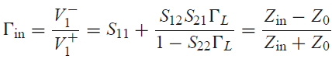
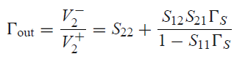
Definitions

Slide 31
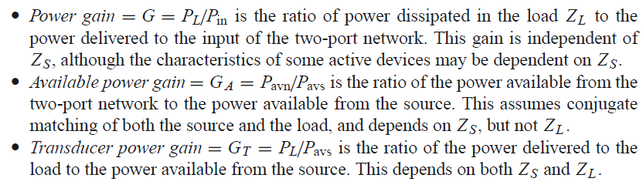
Power gains

Slide 32
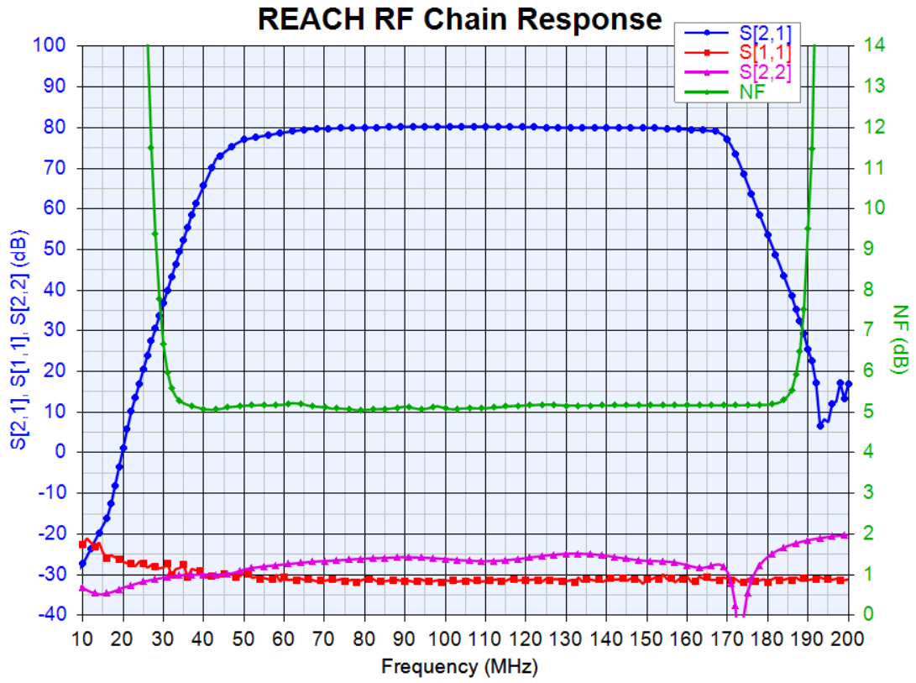

Slide 33
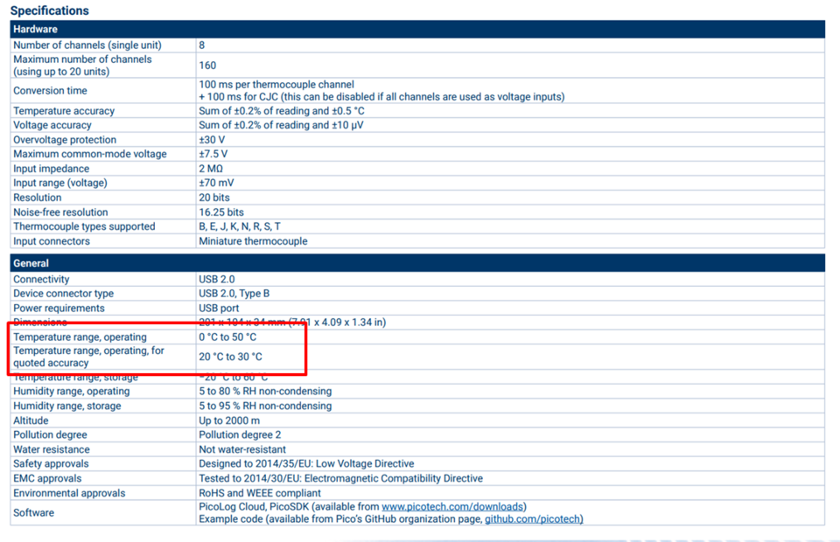
TC08 stability

Slide 34
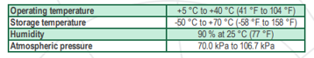
VNA operating conditions

Slide 35
Are the noise wave / noise parameter formalism's equivalent? This came up in a group meeting recently and we didn't reach a conclusion.
What are limitations on our current analytical approaches - ie are there effects that these methods ignore that could be problematic at our scales?
If there is time I would also personally like to understand if we can put any physical constraints on the LNA gain and what is it dependent on?

Slide 36
Paul Scott’s idea
Still need to look into it

Slide 37
Discussion
What

